Slide 1
NE SE Conference 2018
“Practice” in relation to
Somatic Experiencing™
Peter Payne, SEP, RSMET

Slide 2
Practice and SE
SE does not emphasize practice, although Levine gives practices in his books
There are many forms of practice, and each of you is familiar with various kinds
I wish to make a few points about practice in general and how it relates to SE
…as well as to show you a few practices which may be useful in SE.

Slide 3
Swinging Arms
Let’s start with a brief practice that Peter Levine frequently uses with clients in his master classes: I call it Swinging Arms. It can be done with or without weights (or Smoveys).

Slide 4
What do I mean by “practice”?
Intentional action for supporting, developing, or manifesting an ability
2 Kinds of Practice:
1) Daily Practice:
Specific times
and place
For a later result
Skilled activities, physical or mental
Stretching, strengthening and endurance
Meditation

Slide 5
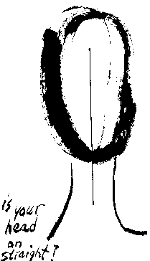
Daylong Practice
Constant
Integrates with other activities
Practice and result are one
Mindfulness
Posture (Alexander Technique)
The Natural State (Bodymind Training)
“Daylong” practice:
Constant
Integrates with other activities
Practice and result are one

Slide 6
Why practice?
Bridge gap between sessions and daily life
Bridge gap between sessions
Promote sense of individual empowerment
Facilitate SE sessions:
Improve therapist abilities
Improve client responsiveness

Slide 7
What to Practice?
In Bodymind Training, you practice the Natural State, a state of balanced open awareness, embodied presence.
This is also the aim of SE (IMHO)
This manifests:
in the Head as lightness, emptiness and clarity;
in the Heart as openness, love and courage; and
in the Hara as groundedness, strength and creativity
What about specific applications to SE?

Slide 8
SE-related goals of practice
Improve interoceptive/spatial awareness
Strengthen the energetic container,
Open specific expressive pathways,
Improve the witness stance,
Encourage autonomic discharge.

Slide 9
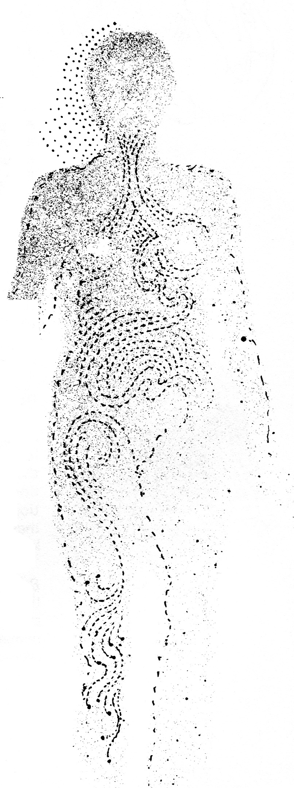
Improve interoceptive and spatial awareness
Terminology: Interoception.
Different meanings in different disciplines
Older and current usage
Visceroception, kinesthesis, vestibular, graviception
Dual nature of touch: C-tactile fibers
Conscious vs non-conscious
Ambiguity in terms of spatial awareness, “energy” sensations
Stimulate and absorb interoceptive sensation:
Self-touch
Movement awareness
Breath awareness/meditating

Slide 10
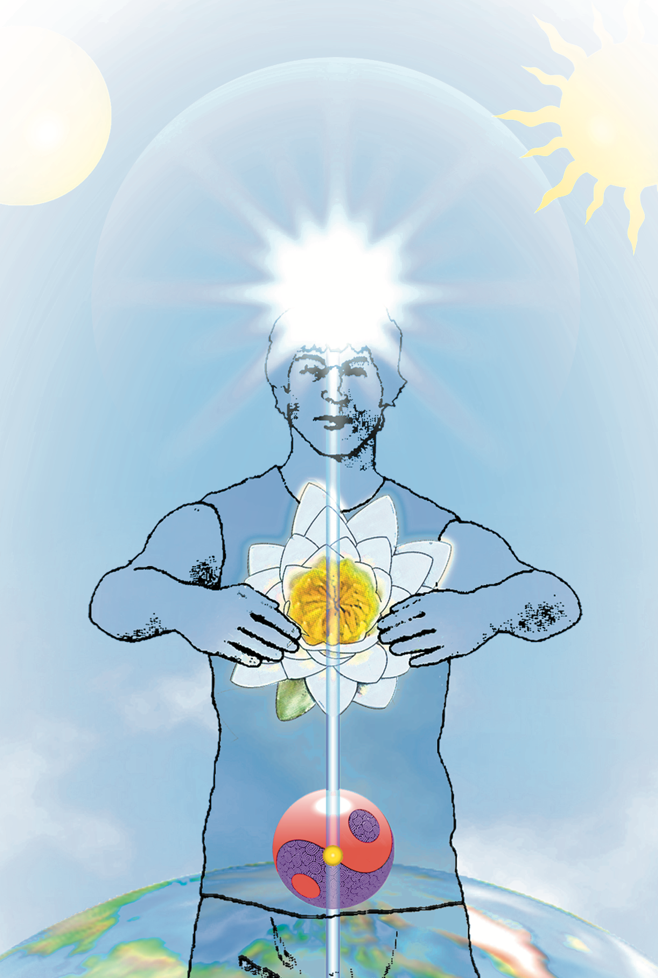
Interoception 2
Difference between sensing and “being in”
Important regions for sensing
Center of Gravity
Centerline
“Chakras”
Lataif
Fascial pathways/meridians

Slide 11
Example: Patting and tapping
Crucial importance of sensing after the exercise, can be taking-off place
for SE work

Slide 12
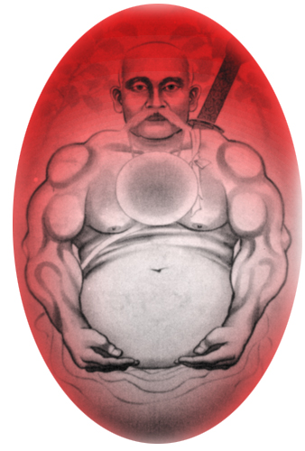
Strengthening the container.
“A strong energetic container means the person has the capacity to tolerate higher levels of (energetic or emotional) charge, remaining strong and flexible rather than rigidifying or discharging too soon. “
Includes making strong boundary
Containment: the Caldron
Fascia
Holds our shape together
Holds electrical charge
Grounding
Qigong, Nei-Jia, Zhan Zhuang, static asanas

Slide 13
Example: Zhan Zhuang (“Standing Like a Tree”)
The “open secret” of great accomplishment in the internal martial arts

Slide 14
Opening Expressive Pathways
Vocalization and gesture
Conscious adoption of instinctive positions and gestures: Shamanic, asanas, Qigong
Moving without moving: using intention and support
Wang Xiang-Zhai, founder of Yiquan, said:
“A small movement is better than a big movement;
no movement is better than a small movement.
Stillness is the mother of all movement.”
This should be readily understood by SE practitioners, and points to the supreme importance of intention and feeling.

Slide 15
Swinging Arms
Often used by Peter (with Smoveys)
Safe and effective way to begin to open channels
Can be used as aerobic or strength exercise
Can lead naturally into Qigong/Taiji type practices

Slide 16
Improving the Witness stance
Levine: “dual consciousness” needed in SE
Hierarchy of awareness practices:
Count breath
Watch breath
Watch flow of experience
Be the witness
Fail to find watcher
Non-dual state
Body-located awareness practices:
Centerline
Center of head

Slide 17
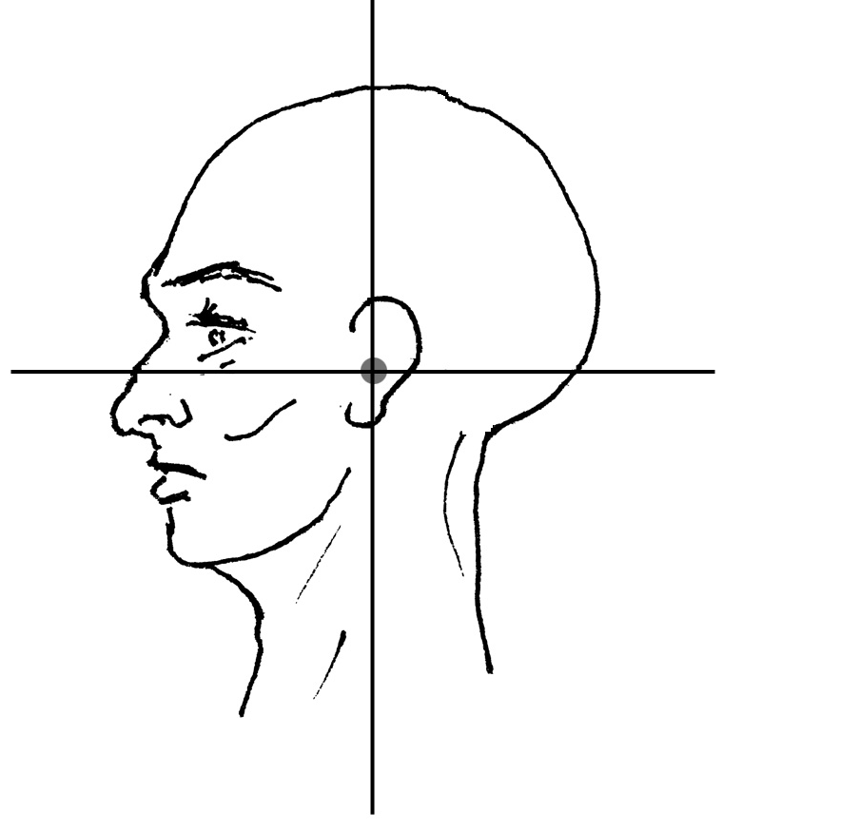
Example: Finding oneself at the Center of the head

Slide 18
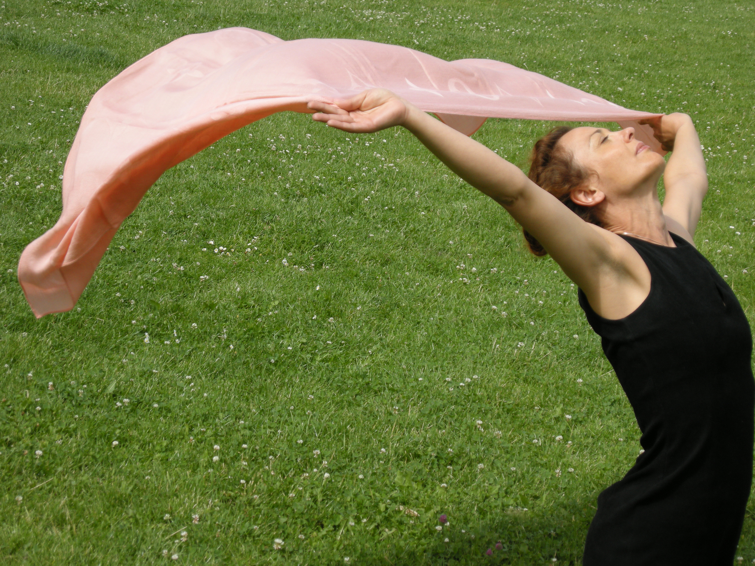
Encouraging Autonomic Discharge
Risky with trauma, huge importance of titration
Free spontaneous movement
Slow intentional movement

Slide 19
Example: Shake it off!

Slide 20
That’s it Folks!
My contact info:
PPPTFE@Gmail.com
www.BodymindScience.INFO

Slide 21
Example: Clearing the Way

